Slide 1

Shutterfly data analysis
Steve Wolfe

Slide 2
Executive summary
The provided dataset is during a 92 consecutive day timeframe between 10/25/2019 and 1/24/2020
Conversion Rate (“Percentage Purchased”) is defined as an aggregation of “Purchased within 7 Days” / “Audience” by path grouping
When viewing at “Critical Path” only, there are 16 unique combinations. The highest “Percentage Purchased” (~38%) for “Purchased within 7 Days” comes from the combination:
  Has Not Shopped / Has Started Project / Has Added to Cart / Has Not Checked Out
When viewing all flags, there are 1,111 unique combinations. The highest “Percentage Purchased” (~79%) comes from the combination:
  Has Shopped / Has Started Project / Has Added to Cart / Has Not Checked Out / Has Uploaded Photos / Has Visited on Previous Day / Has 4 Different Products / Has 3 Number of Platforms
Looking at a multi-variate analysis, the largest correlation to “Purchased within 7 Days” is “Audience” (~84%)

Slide 3
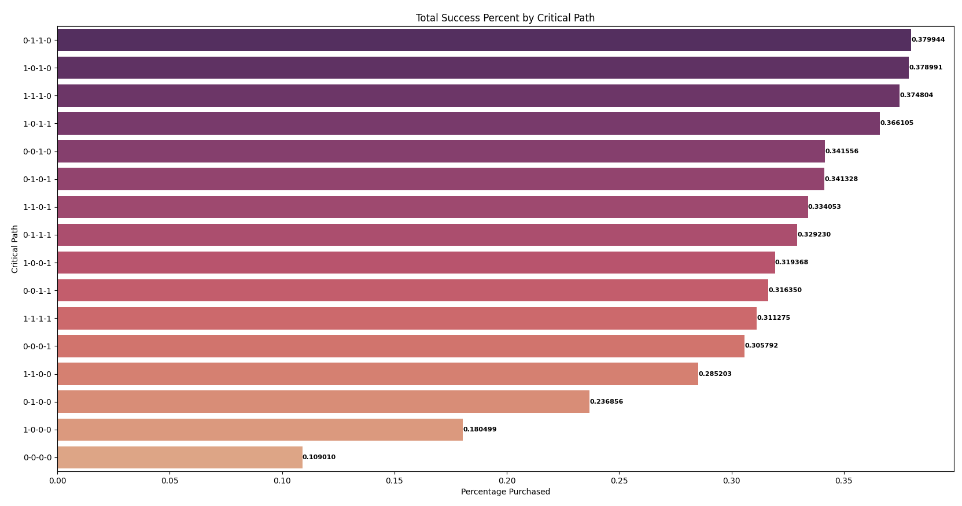
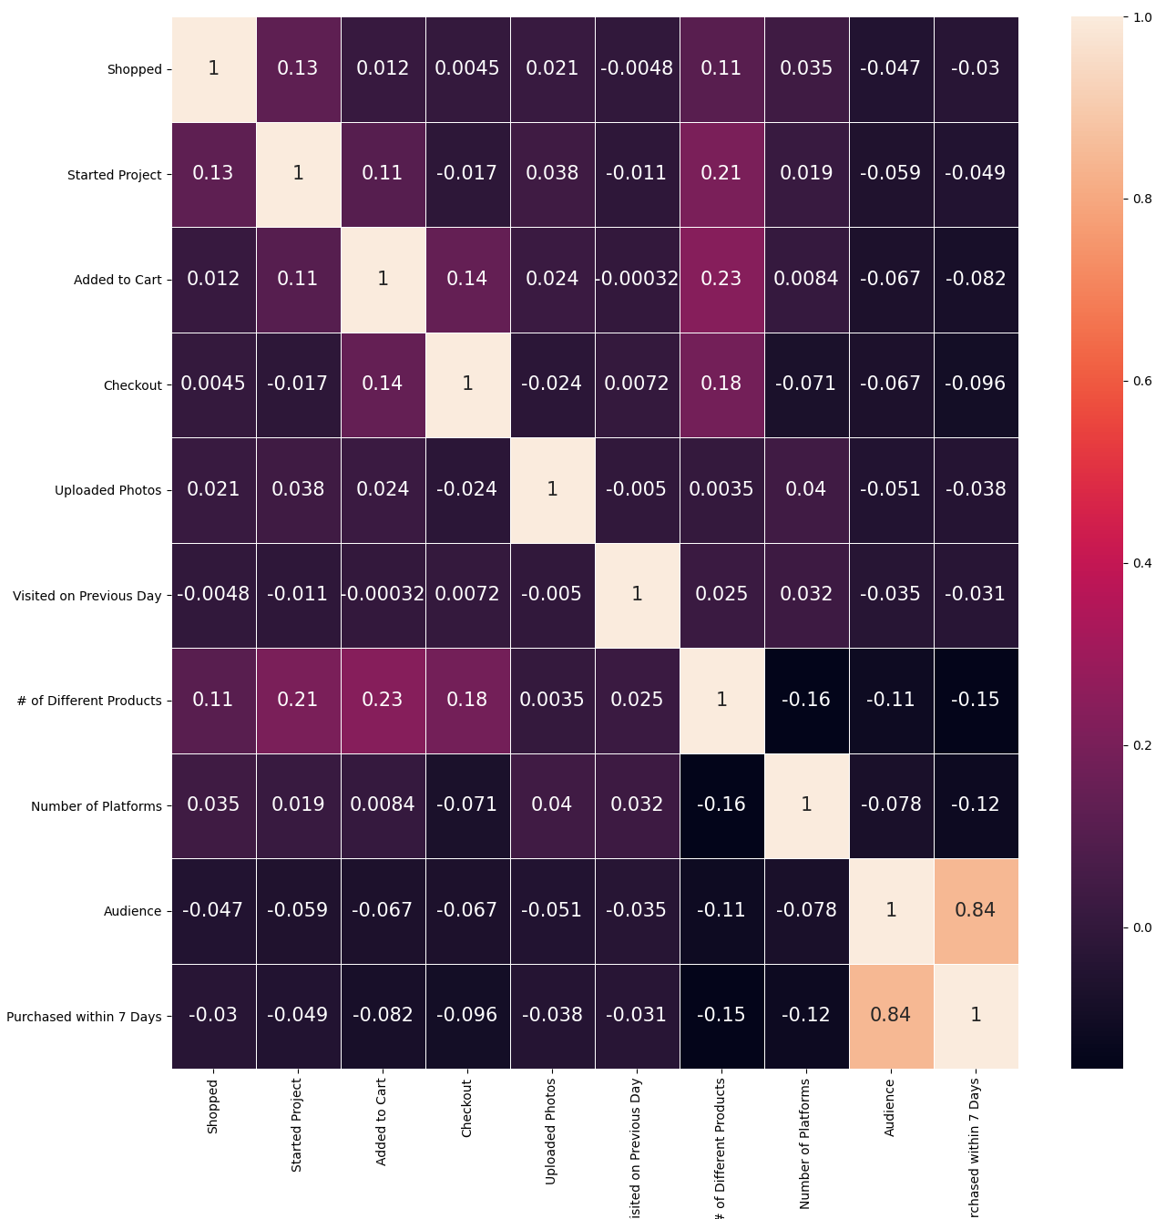
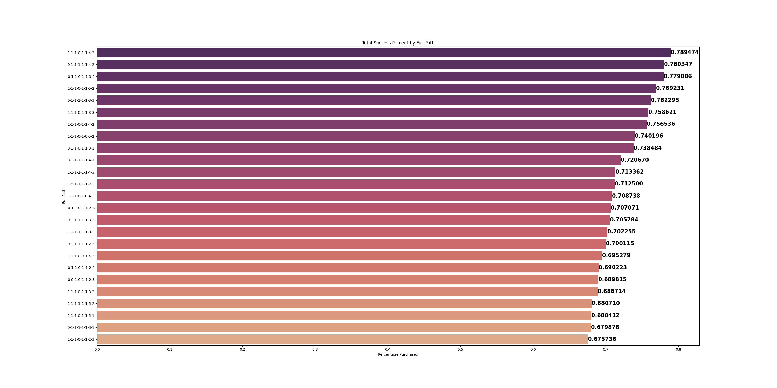

Slide 4
Further follow-ups
Other Data Needed
  I would really like to better understand user tracking within the website / applications.
  Since this data only counts the total number of unique people who purchased, it would be valuable to also track quantities of products? Is one more important than the other? This data would be valuable in tracking down which types of people are more likely to purchase what product, depending on where in the process they’ve been.
  What actions are going to be done with this data? Knowing the audience, and what actions they’re going to perform with the analysis would help me understand what kind of data visualizations would be best to tell the story. The ones I chose were basic to understanding the dataset.
  Having this data at the end user level, and tracking it by day, would create a much more powerful story. I would be able to analyze how many days it was since they visited that they ended up purchasing, along with how many site visits it takes to convert to a purchase. When looking at larger aggregation values, all that data is confounded into the large sums.
Other Information
  I did most of the analysis in Python. However, I’ve also included partial analysis in both Excel and PowerBI. I just wanted to demonstrate that similar outputs could be achieved in a multitude of tools.
  I’m not sure what decimal requirements are used at Shuttefly, but I left at largest presentable values. I would typically use a max of 1 point in analysis, though.
  For the “Full Path” visual, it’s limited to the top 25 rows by “Purchased within 7 Days” for all combinations. Also, it’s only looking at combinations that occurred at least 75% of the count of unique days to remove special cause rows. This is better commented in the Python code.

